Slide 1

Notes:
Hello everyone, we are Team Number 3. Today, we’re presenting our final results on the Bakery Sales Forecasting project. Our goal over the last 10 weeks was to take raw sales and weather data and build a machine learning model capable of predicting daily turnover for different bakery products. I’d like to introduce my team: Louisa Lagmoellar, Andrews Mensah (myself), Akshay Patil and Aadip Thapaliya. Let’s dive into our data.

Slide 2
List and brief description of self-created variables
Overview: To improve our model's ability to capture seasonality and trends, we engineered several features from the raw Datum column.
Variables:
  Year, Month, Day: Extracted to capture annual growth and monthly seasonality.
  Weekday: Integer values were assigned (0=Monday, 6=Sunday) to capture weekly cycles.
  IsWeekend: Boolean flag (True for Saturday/Sunday) to capture the high traffic on weekends.
  KielerWoche: Binary flag (1 during the event, 0 otherwise). Accounts for the massive influx of visitors during the festival.
Notes:
Before feeding any data into a model, we had to prepare it. We quickly realized that raw dates and temperatures weren't enough to explain sales spikes. We created several key features:
IsWeekend: We noticed sales behave very differently on Saturdays and Sundays compared to weekdays, so we created a binary flag for this.
Year, Month, Day: Extracted to capture annual growth and monthly seasonality.
Weekday: Integer values were assigned (0=Monday, 6=Sunday) to capture weekly cycles.
KielerWoche: Since this festival is a massive event in Kiel, we created a specific variable to flag these days.

Slide 3
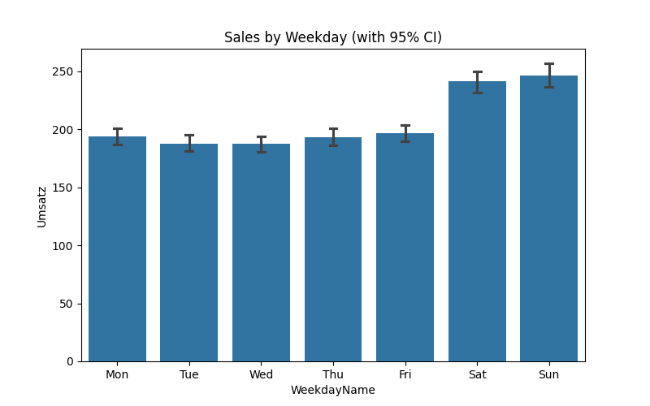
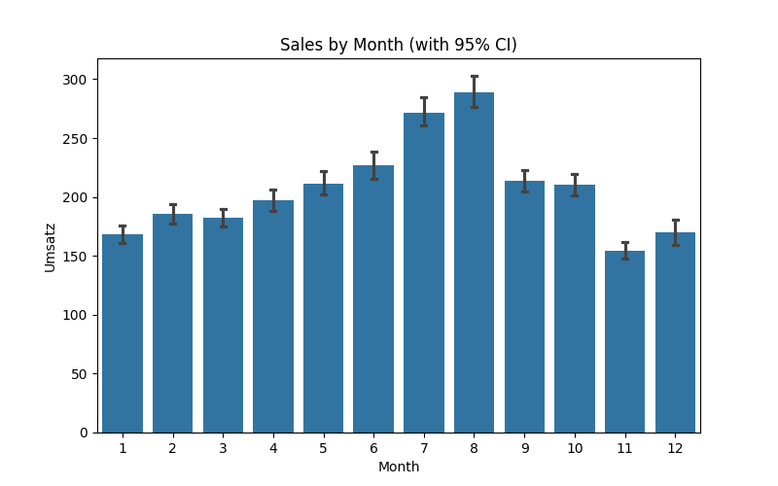
Bar charts with confidence intervals for two self-created variables
Notes:
To confirm our hypothesis that these features matter, we visualized the data.
[Point to Left Chart]: Here you see the average sales on Weekends versus Weekdays. The difference is stark, and the small black lines—the 95% confidence intervals—do not overlap, proving this difference is statistically significant.
[Point to Right Chart]: Similarly, during the Kieler Woche, sales skyrocket compared to normal days. This confirmed that our 'KielerWoche' feature would be a powerful predictor for our models.
Now I transfer to Aadip to present our Baseline model.

Slide 4
Baseline Model - Linear Regression
Model Equation:
Sales = β0 - 70.68 (Warengruppe_1) + 218.58 (Warengruppe_2) - 27.87 (Warengruppe_3) - 103.27 (Warengruppe_4) + 88.88 (Warengruppe_5) - 105.64 (Warengruppe_6) + 47.88 (IsWeekend) + 1.13 (Weekday) + 14.84 (KielerWoche) + 3.92 (Temperature) + 0.15 (WindSpeed) - 0.08 (CloudCover) + 0.01 (WeatherCode) - 11.48 (Year) - 1.06 (Month) + 0.35 (Day)
Key Drivers:
Product Type: The strongest predictor (Group 2 sells +218€ vs baseline).
Seasonality: Weekends (+48€) and Events (+15€) are significant positive drivers.
Model Performance:
Validation Adjusted R²: 0.6859 (Strong Baseline).
Validation MAPE: 32.12%.
Conclusion: The model explains ~69% of the variance in sales, proving that basic features (Product + Time) work well. However, a 32% average error is still too high for precise inventory planning.
Notes:
We started with a Linear Regression baseline, and it actually performed surprisingly well. Here is our model equation and the key drivers in our analysis were Warengruppe_2 (Product group 2), Sales on weekends and Kielerwoche (Events).
The Good News: Our Adjusted R² is 0.69. This means our simple linear model explains nearly 70% of the fluctuation in sales. This confirms that our core features—like Product Group and IsWeekend—are indeed the main drivers of demand.
The Bad News: Despite the high R², our Mean Absolute Percentage Error (MAPE) is 32%.
What this means: While the model captures the general trend, its individual daily predictions are often off by about a third. For a bakery, missing inventory by 30% results in too much waste or too many empty shelves.
Next Step: This justifies moving to a Neural Network.

Slide 5
Type of missing value imputation used
Challenge: The weather dataset and Kieler Woche contained missing entries.
Imputation Strategy:
KielerWoche & Wettercode Dataset: Filled NaN with 0 (Assumed "No Event" / "No significant weather" if missing). Reasoning: This is a structural decision, not a guess. Since the original files only listed dates when the festival or a weather event actually occurred, any date that didn't match during our merge is logically a 'non-event' day. Therefore, treating NaN as 0 correctly represents 'No Festival' or 'Normal Weather'.
Weather Imputation (Temp, Wind, Clouds): Used Forward Fill followed by Backward Fill. Reasoning: Weather conditions (like temperature or cloud cover) typically persist over short periods. Using the last known value is a safe, logical baseline (Persistence Model).
Notes:
KielerWoche & Wettercode (Events Gap): For the event variables, we filled missing values with 0. This is a structural decision, not a guess. Since the original files only listed dates when the festival or a weather event actually occurred, any date that didn't match during our merge is logically a 'non-event' day. Therefore, treating NaN as 0 correctly represents 'No Festival' or 'Normal Weather'.
Weather Imputation: For the weather data, we used a Forward Fill strategy. Instead of calculating a mathematical average or drawing a line between points, we simply carried the last known temperature or wind speed forward to fill any gaps. This approach—often called a 'Persistence Model' in meteorology—assumes that the weather next hour is most likely the same as it is right now. This prevents us from introducing artificial fluctuations into the data.
Now I transfer to Akshay to present our Neural nets model.

Slide 6
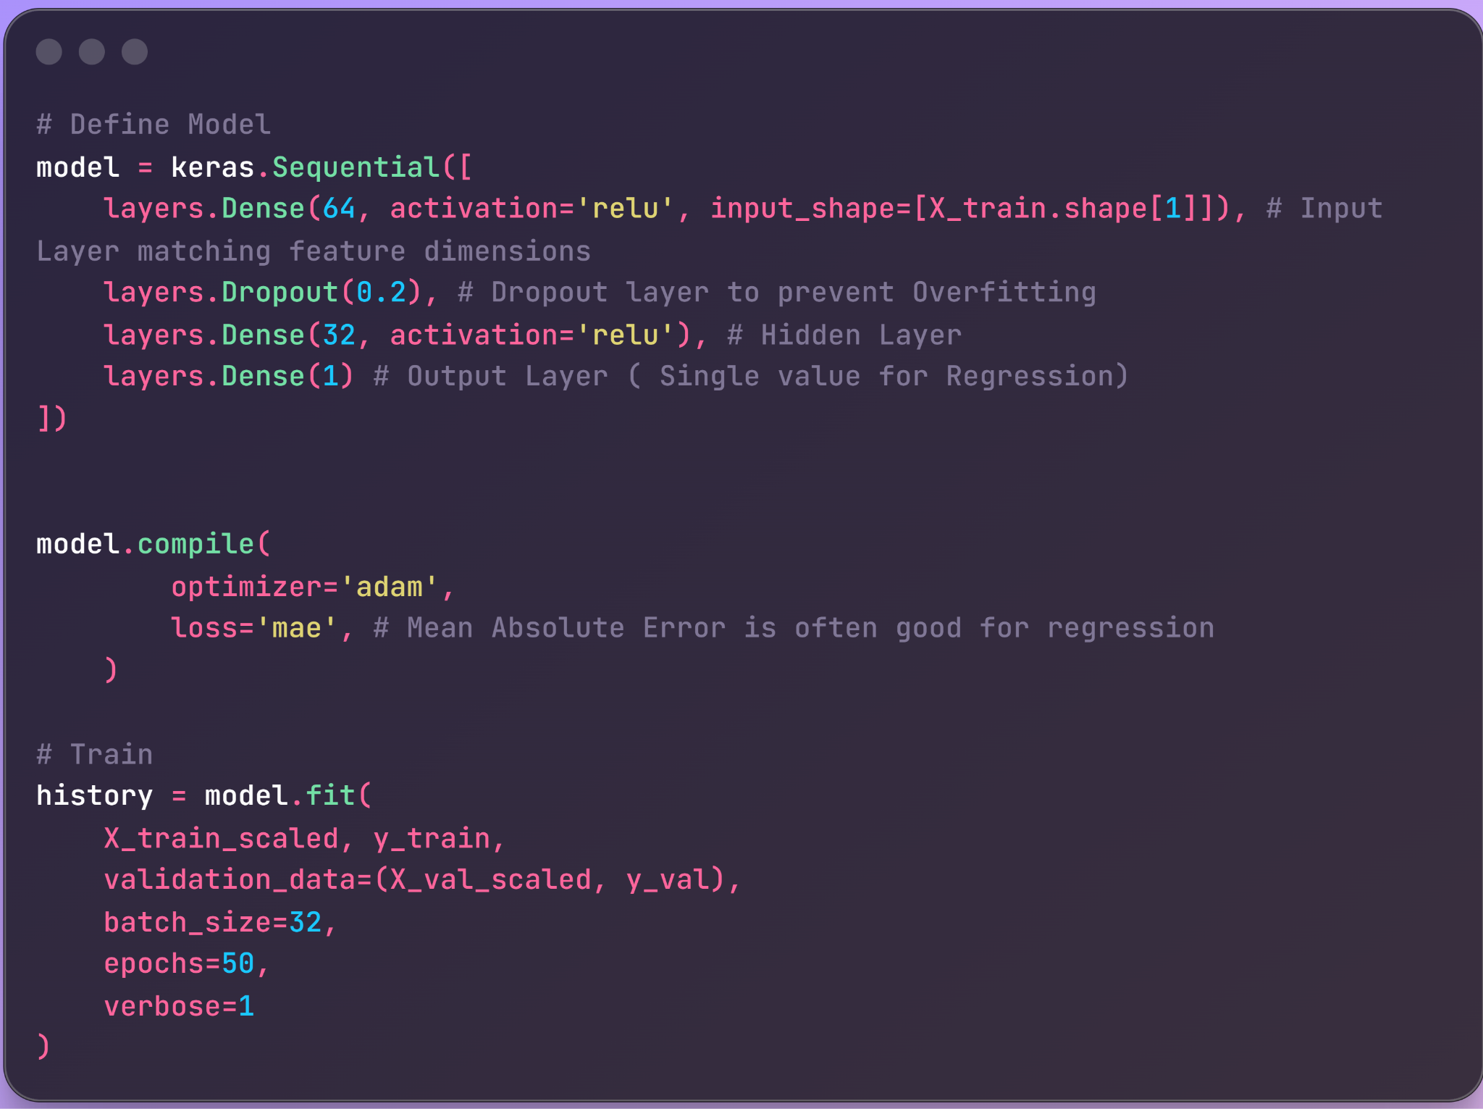
Neural network model
Notes:
Now our baseline model had Mean Absolute Percentage Error (MAPE) is 32%.So, We need a model that can handle the remaining 30% of complexity—the non-linear interactions—to drive that error rate down that we could not do in our baseline model.
Moving on to our optimized solution, we implemented a Feed-Forward Neural Network using TensorFlow and Keras. Let me walk you through the architecture we chose and why:
Network Structure: We designed a network with two main hidden layers.
The first layer has 64 neurons to capture the broad patterns in the data.
The second layer narrows down to 32 neurons to refine those patterns.
We used ReLU activation functions throughout because they are computationally efficient and handle non-linear relationships well.
Handling Overfitting: A critical addition here is the Dropout Layer (set to 0.2).
Why? Neural nets can easily memorize training data. This layer randomly 'turns off' 20% of the neurons during training, forcing the network to learn robust features rather than just memorizing noise.
Output & Compilation:
The Output Layer has just 1 unit because this is a regression task—we are predicting a single continuous number (Sales).
For the loss function, we chose Mean Absolute Error (MAE) instead of Mean Squared Error.
Reasoning: Sales data can have outliers (like the Kieler Woche spikes). MAE is less sensitive to outliers than MSE, preventing the model from being thrown off by a few extreme days.
Training: We trained for 50 epochs using the Adam optimizer, which adjusts the learning rate automatically, making the training process faster and more stable

Slide 7
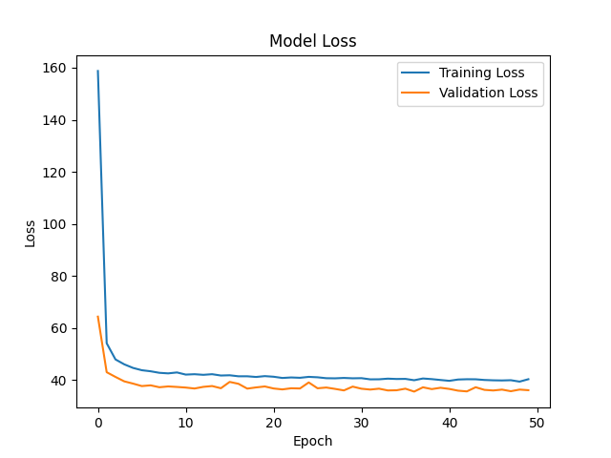
Neural Network Training
Observations:
The training loss decreases steadily, indicating the model is learning.
The validation loss stabilizes around 50 epochs, suggesting the model has converged without significant overfitting (thanks to the Dropout layer).
Notes:
The results were a significant step up from the baseline.
[Point to Graph]: As you can see in the Loss Curve, both training and validation error decreased steadily and converged, which tells us our Dropout strategy worked—we avoided overfitting.

Slide 8
Neural Network Results (MAPE)
Overall Validation Performance:
Neural Net Validation MAPE: 0.2018 (20.18% ). On average, our predictions are off by ~20.18%)
Performance by Product Group:
Warengruppe 1: 0.2342 (23.4%)
Warengruppe 2: 0.1380 (13.8%) (Best performing group)
Warengruppe 3: 0.2042 (20.4%)
Warengruppe 4: 0.2394 (23.9%)
Warengruppe 5: 0.1451 (14.5%)
Warengruppe 6: 0.5812 (58.1%) (Hardest to predict)
Notes:
Performance: Our overall Error (MAPE) dropped from 32% (baseline) to around 20.2%. This is a solid improvement, essentially cutting our prediction error by a third.
Detail: It’s worth noting that Product Group 2 was the easiest to predict with only ~13.8% error, likely due to stable daily demand. On the other hand, Product Group 6 remained highly volatile and was our hardest to forecast, with an error rate of ~58%.
Now I transfer to lousia to present

Slide 9
"Worst Fail" vs. "Best Improvement"
Worst Fail (The Model's Blind Spot)
  Date: 2017-12-31 (New Year's Eve)
  Actual Sales: 1,432.42 €
  Predicted: 262.21 €
  Error: 1,170.21 € (Underestimated by ~82%)
  Diagnosis: The model treated this as a regular Sunday. It failed to capture the massive, irregular demand spike specific to New Year's Eve.
Best Improvement (Model Strength)
  Date: 2017-08-13 (Summer Sunday)
  Actual Sales: 537.19 €
  Predicted: 515.50 €
  Error: 21.69 € (Only ~4% Error)
  Success Factor: Unlike the linear baseline, the Neural Network correctly identified the non-linear interaction between "Sunday" and "Summer Weather," predicting the high volume almost perfectly.
Notes:
Let's look at two specific examples to understand where our model succeeds and fails.
First, the Worst Fail: Our model completely missed New Year's Eve (Dec 31st). It predicted 262€—which is a typical Sunday sales figure—but the actual demand was over 1,400€. Why? The model only knows it's a 'Sunday in December.' It doesn't have a specific feature for 'New Year's Eve,' so it couldn't foresee the massive holiday rush. This is a clear signal that we need a 'Public Holiday' calendar feature in the future.
But look at the Best Improvement: On August 13th, a busy summer Sunday, the model was spot on. It predicted 515€ against an actual of 537€—an error of just 4%. The Baseline Linear Model typically underestimates these peak days because it uses a fixed 'Weekend' adder. The Neural Network, however, was smart enough to combine 'Weekend' + 'August' + 'Good Weather' to predict the high demand accurately

Slide 10
Conclusion
Summary:
Transitioning from Linear Regression to Neural Networks improved prediction accuracy by ~37% (MAPE dropped from 32.1% to 20.2%).
Key Learnings:
Feature Engineering: Simple flags (Weekends/Holidays) were more impactful than complex raw data.
Non-Linear Patterns: Neural Networks successfully captured complex interactions (e.g., Summer + Weekend) that linear models missed.
Next Steps:
Incorporate "School Holidays" and specific "Public Holidays" (like New Year's Eve) as explicit features to fix the "Worst Fail" cases.
Notes:
In conclusion, we successfully improved our forecast accuracy by over a third by moving from Linear Regression to Neural Networks.
Key Takeaways:
Feature Engineering is King: We found that simple variables like 'IsWeekend' were often more important than raw weather data.
Complexity Pays Off: The Neural Net handled the messy, non-linear real-world data much better, reducing our error rate from 32% down to ~20%.
Next Steps: To fix our 'Worst Fails'—like the massive miss on New Year's Eve—our immediate next step would be to integrate a dedicated 'Public Holiday' calendar.
Thank you for listening! We are happy to take any questions.

